Slide 1





AGRICULTURAL RAW MATERIAL ANALYSIS
Team : FAISAL AHAMED W &
faisalahamed2311@gmail.com
78C2BCF7ABC6BFB82E848950EAA34,
Guide: P. Raja
(Master Trainer Edunet foundation)
Disclaimer: The content is curated for educational purposes only.
Notes:
Slides: Prepare a short slide deck (10-12 slides) summarizing the project objectives, methodology, and key results.

Slide 2
OUTLINE
Abstract of the Project
Problem Statement
Proposed Solution
System Architecture
Live Demo of the Project
Embedded Video of Project
Conclusion
Future Scope

Slide 3
Abstract
This study conducts a comprehensive analysis of agricultural raw material prices over the years, utilizing exploratory data analysis (EDA) techniques to uncover key insights. The analysis aims to identify both high-range and low-range raw materials based on their pricing trends, providing a clearer picture of market dynamics. By examining percentage changes, we pinpoint materials that have experienced significant price fluctuations, both positively and negatively. Additionally, we explore the overall range of price changes over time, highlighting volatility and stability within the sector. To visualize relationships among various raw materials, a graph is generated to illustrate correlations between price changes, enabling stakeholders to make informed decisions based on data-driven insights. This research serves as a valuable resource for farmers, traders, and policymakers in understanding the agricultural market landscape.

Slide 4
Problem Statement
The agricultural sector is heavily influenced by fluctuations in raw material prices, which can impact production costs, profitability, and market stability. This analysis seeks to address the following challenges within the context of agricultural raw materials: 1. Price Range Identification: Determine which agricultural raw materials fall within high and low-price ranges over the years, providing insights into the market dynamics and the materials that dominate pricing. 2. Percentage Change Analysis: Identify raw materials that have experienced the highest and lowest percentage changes in price. Understanding these fluctuations can help stakeholders anticipate market trends and adjust strategies accordingly. 3. Price Change Range Assessment: Analyze the overall range of price changes for agricultural raw materials over the specified period. This will highlight the volatility of the market and assist in forecasting future trends. 4. Correlation Mapping: Create a heatmap to visualize the correlations between the price changes of different raw materials. This will aid in understanding how the prices of various materials are interconnected, which is crucial for making informed decisions in trading and procurement. The significance of analyzing agricultural raw material prices lies in its potential to impact various stakeholders and enhance decision-making processes within the agricultural sector.

Slide 5
Proposed Solution
The proposed solution involves a comprehensive Exploratory Data Analysis (EDA) and predictive modeling approach to analyze the historical prices of agricultural raw materials. The goal is to uncover insights related to price trends, volatility, correlations, and market behavior that will enable stakeholders to make informed, data-driven decisions. The solution will involve the following key steps: Data Collection and Preparation Exploratory Data Analysis (EDA) Correlation Analysis Predictive Modeling (Optional) Visualization and Reporting

Slide 6
System Architecture
Hardware Requirements:
CPU : Minimum: Intel Core i5 (or equivalent) with at least 4 cores.
RAM: Minimum: 8 GB RAM. Recommended: 16 GB or more for smoother processing, especially when running advanced analytics or handling large datasets.
GPU (if using machine learning models that require heavy computations, such as neural networks or deep learning models): Minimum: Integrated GPU (e.g., Intel UHD, AMD Vega). Recommended: NVIDIA GeForce GTX or RTX series for deep learning (if working with large-scale models or time-series forecasting models such as LSTMs).
Storage: Recommended: 500 GB or more SSD for faster read/write speeds when working with large datasets.

Slide 7
System Architecture
Software Requirements:
Operating System: Windows: Windows 10 or later, 64-bit version.
Programming Languages and Development Environments
Python (recommended language for data analysis, machine learning, and visualization):
Python Version: Python 3.7 or later.
IDEs:
Jupyter Notebooks (for interactive development and visualization).
VS Code or PyCharm (for more extensive project development).
R (optional, for statistical analysis and visualization):
R Version: R 4.0 or later.
IDE: RStudio.
Machine Learning and Forecasting:
Scikit-learn: For machine learning models, including regression, classification, clustering, and clustering techniques.
TensorFlow / Keras: For deep learning models (LSTM, neural networks) for time-series forecasting.
XGBoost: For boosting algorithms and regression models.
Statsmodels: For statistical modeling and time series analysis (ARIMA models).

Slide 8
System Architecture
Data Requirements:
Historical Price Data: External Factors
Real-Time Data
Network and Security Requirements:
Internet Connection
Security

Slide 9
Live Demo of Project

Slide 10
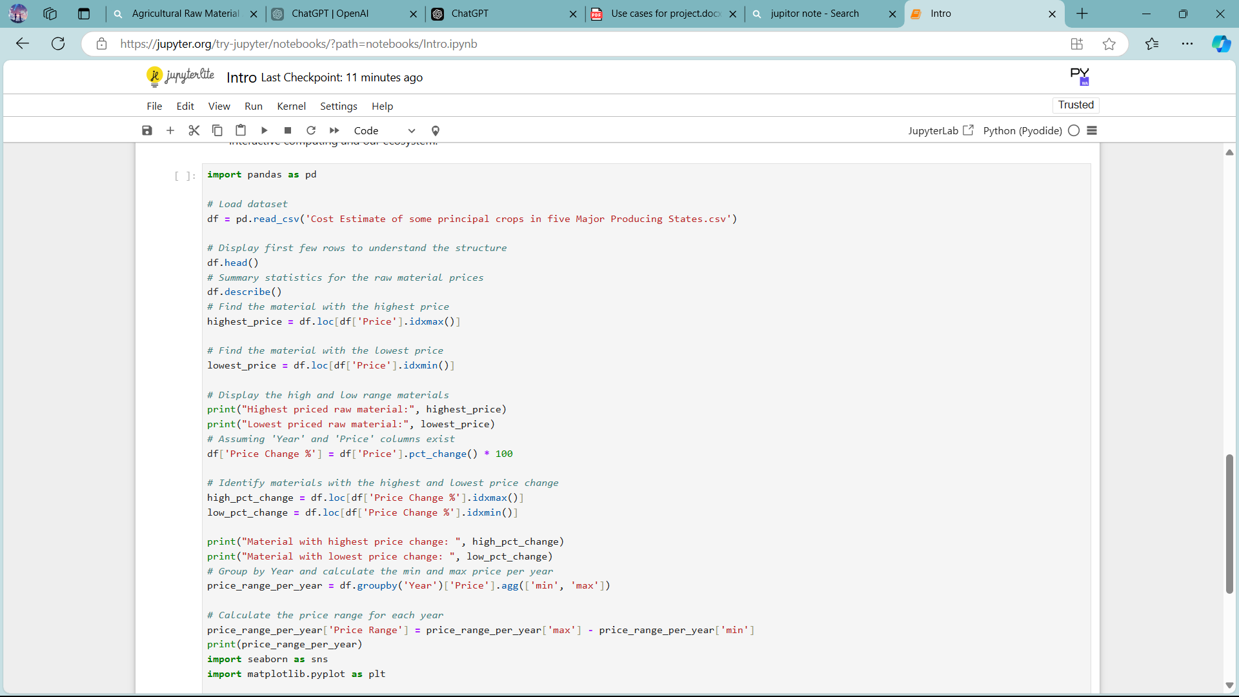
RESULT

Slide 11
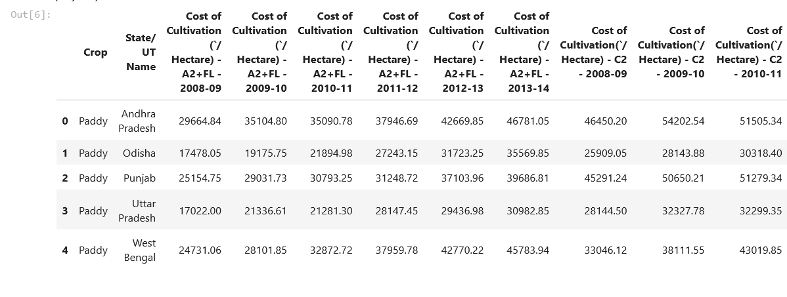
RESULT

Slide 12
Conclusion The project aimed to conduct an Exploratory Data Analysis (EDA) of agricultural raw material prices over the years, with the goal of uncovering key insights into price trends, fluctuations, and relationships between variables. The analysis focused on four primary objectives: Identifying the high range and low range raw materials based on their prices. Analysing the high and low percentage change in prices for different materials. Determining the range of price changes over the years. Mapping correlations between different variables, using a heatmap, to uncover patterns and relationships in the dataset. Through the analysis, we identified the raw materials with the highest and lowest prices over the analyzed period. Materials with high percentage changes were often subject to market shocks, such as supply chain disruptions, climate events (e.g., droughts), or sudden changes in global demand.

Slide 13
Future Scope The Agricultural Raw Material Price Analysis project provides a strong foundation for understanding market dynamics and making data-driven decisions. However, the field is constantly evolving, and there are numerous avenues for further exploration and enhancement. Below are potential future directions for expanding and refining this analysis: Weather and Climate Data: Agricultural prices are significantly impacted by weather conditions, such as droughts, floods, and temperature fluctuations. Integrating historical and real-time climate data with the pricing dataset can enhance predictions and risk assessments. For example, predictive models could forecast price changes based on upcoming weather patterns. Sentiment Analysis on News and Social Media: Machine learning models could be used to perform sentiment analysis on news articles, social media, and other sources to gauge the mood of the market. For instance, news of a crop failure or a new trade policy could significantly affect agricultural prices, and sentiment analysis could be used to predict how such events may impact future prices.

Slide 14
Thank you!
Notes:
thank you very much for joining this PPT, keep learning.
14

